Slide 1
Time series analysis of rainfall events and their gravity response at the Southern African Geodynamic Observatory, Sutherland by
Mahed, G^{1,3}, de Wit, M³, Blume, T² Guntner, A² , Abe, M² and Fourie, P⁴
1) AEON-Africa Earth Observatory Network, Nelson Mandela Metropolitan University, South Africa
2) Helmholtz Centre for Geosciences, GFZ, Potsdam, Germany
3) AEON, Faculty of Science, Nelson Mandela Metropolitan University, South Africa
  4) South African Astronomical Observatory (SAAO), Observatory Road, Observatory, South Africa

Slide 2
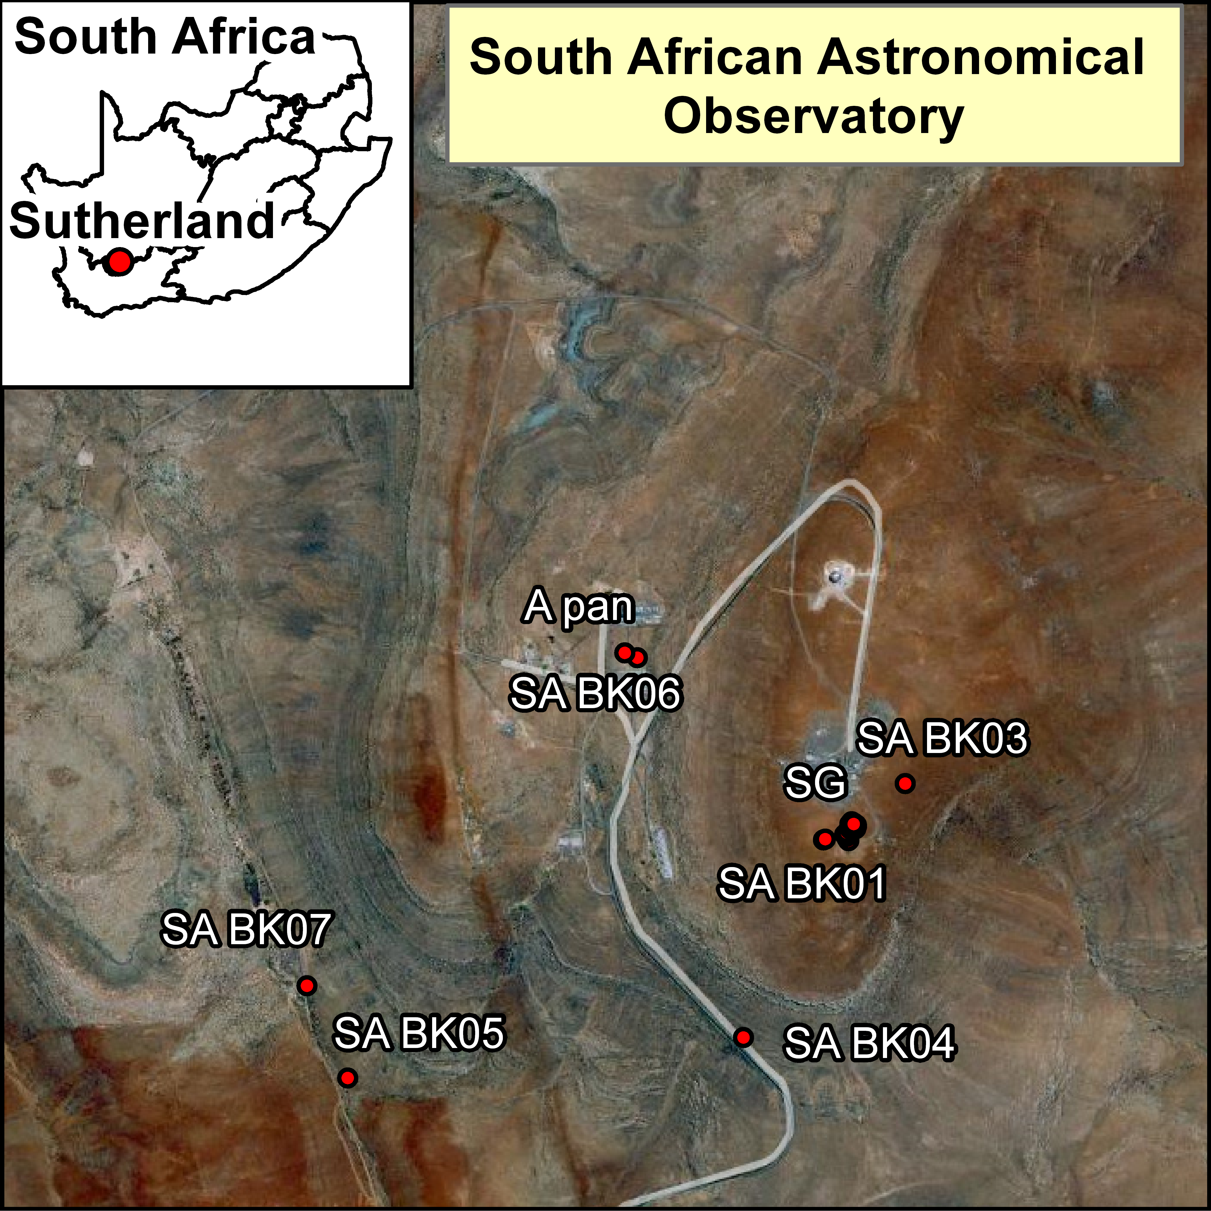
Site location

Slide 3
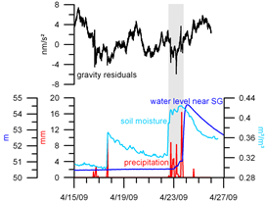
Background
Kroner et al. (2007)

Slide 4
Precipitation and evaporation

Slide 5
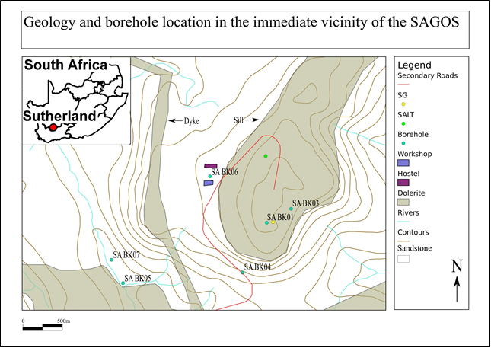
Geology of the study area

Slide 6
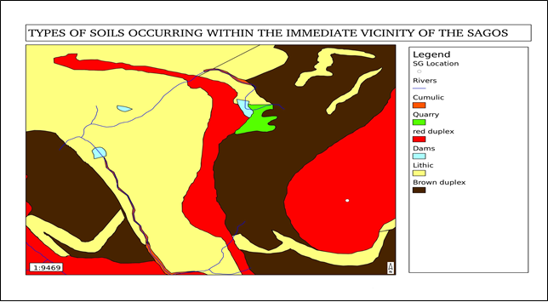
Soils of the study area

Slide 7
Methodology
Days were precipitation exceeded evaporation were targeted
Precipitation events with multiple days of rain were further studied
Change in water level was calculated for SA BK 07 on these days
The change in water level was correlated to the gravity residual for all precipitation events

Slide 8
Rainfall Event | Date of rainfall event | Evaporation(mm) | Precipitation(mm) | Precipitation – Evaporation(mm) | Correlation between gravity residual and change in groundwater level
1 | 20021220 | 12.9 | 16.9 | 4 | 0.63
2 | 20021221 | 5.5 | 11 | 5.5 | -0.42
3 | 20030822 | 2 | 10.2 | 8.2 | 0.51
4 | 20030916 | 3.9 | 4.3 | 0.4 | 0.71
5 | 20031123 | 6.1 | 6.6 | 0.5 | 0.9
6 | 20040401 | 5.8 | 13.8 | 8 | 0.43
7 | 20040402 | 5 | 7 | 2 | -0.46
8 | 20040415 | 6.4 | 17.2 | 10.8 | 0.1
9 | 20040416 | 6.4 | 10.6 | 4.2 | -0.37
10 | 20040807 | 0.9 | 1.4 | 0.5 | 0.46
11 | 20041020 | 5.2 | 12.2 | 7 | 0.05
12 | 20041222 | 3.2 | 5.2 | 2 | -0.63
13 | 20041224 | 7 | 16 | 9 | 0.42
14 | 20050118 | 7.7 | 8.2 | 0.5 | 0.26
15 | 20050119 | 0.9 | 11.4 | 10.5 | 0.58
16 | 20050120 | 5 | 12 | 7 | 0.23
17 | 20050220 | 3.8 | 7.8 | 4 | -0.79
18 | 20050503 | 4.6 | 13.6 | 9 | 0.01
19 | 20060822 | 1.8 | 29.3 | 27.5 | -
20 | 20060823 | 4.2 | 14.2 | 10 | -

Slide 9
Precipitation events
 | Rainfall event | Start Date | End date | Cumulative precipitation(mm) | Correlation
A | 1 and 2 | 20021220 | 20021221 | 27.9 | 0.63
B | 6 and 7 | 20040401 | 20040402 | 20.8 | -0.01
C | 8 and 9 | 20040415 | 20040416 | 27.8 | 0.68
D | 14,15 and 16 | 20050118 | 20050120 | 31.6 | 0.32
E | 20 and 21 | 20060822 | 20060823 | 37.5 | -

Slide 10
Time series

Slide 11
Time series

Slide 12
Preliminary conclusions and way forward – hydrology and time series
No definite correlation between SABK07 and gravity residual for precipitation events
Graphical inverse relationship present between change in water level in SA BK 07 and gravity residual for multiple precipitation events
Work in progress:
Time series analysis of soil moisture and groundwater
Hydrological modelling
Comparison between gravity residual and hydrological modelling

Slide 13
Acknowledgements
Benjamin Creutzfeldt and Stefan Leudtke of the GFZ Section 5.1 (Hydrology)
Hartmut Pflug of the GFZ Section 1.2 (Gravimetry)
Moctar Doucouré of AEON

Slide 14
Thanks for listening!

